Slide 1
Use of sun-photometry to investigate the COVID-19 lockdown effects on the atmospheric composition in various Italian urban sites
Monica Campanelli, A.M. Iannarelli, G. Mevi, S. Casadio, H. Diémoz, S. Finardi,
A. Dinoi, E. Castelli, A. di Sarra, A. Di Bernardino, G. Casasanta, C. Bassani, A.M.
Siani, M. Cacciani, F. Barnaba, L. Di Liberto, and S. Argentini

Slide 2
The COVID-19 outbreak is still affecting many countries.
In 2020 severe restriction policies during winter-spring to limit and slow down the transmission of the SARS-CoV virus.
international borders were closed
lockdown restrictions for many millions of people
reduced transport
change in energy consumption patterns.
Restrictions in Italy were regulated by several legislative decrees (Decreto del Presidente del Consiglio dei ministri, DPCM)
DPCM-1, February 23, 2020 in two regions in northern Italy suspended most of the in-person activities, school classes and on-site work; transport services for goods and people by both land and rail, with few exceptions, were also interrupted.
DPCM-2, March 9, 2020 extending the restrictions of DPCM-1 to the entire Nation.
DPCM-3, March 22, 2020 all on-site industrial and commercial activities were suspended ( with some exceptions).
DPCM-4, stated that since May 4, 2020, journeys motivated by proven work needs or other necessities and travel to meet relatives were allowed. The on-site industrial work restarted.

Slide 3
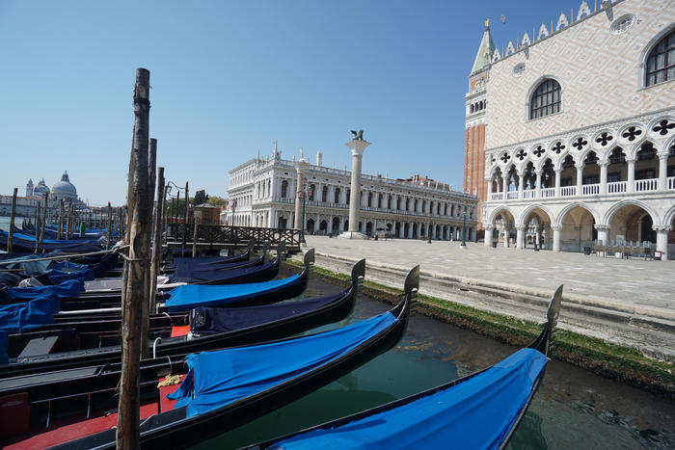
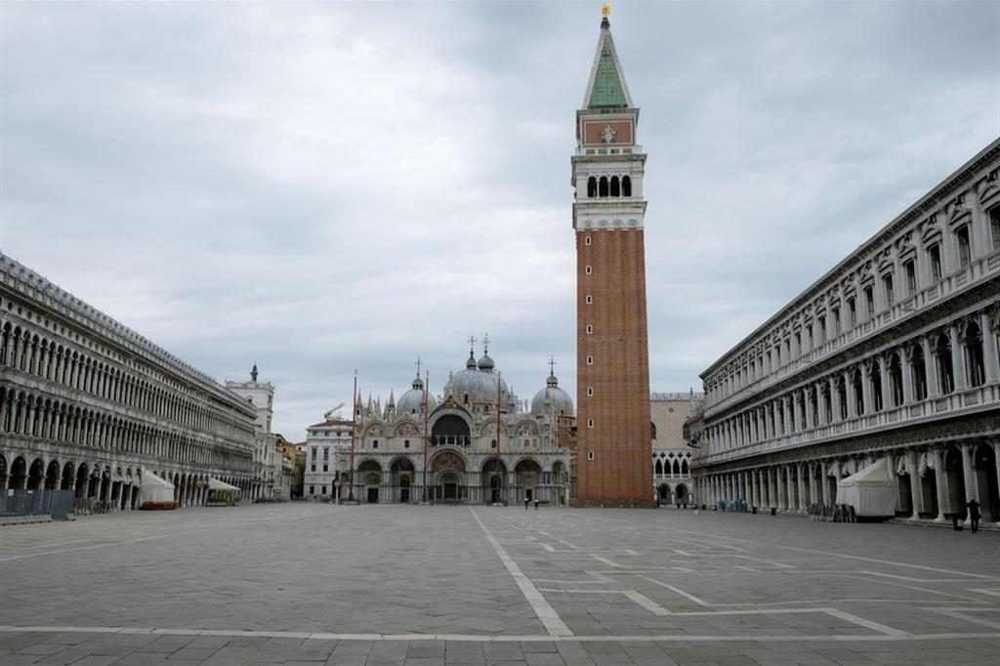
Venice

Slide 4

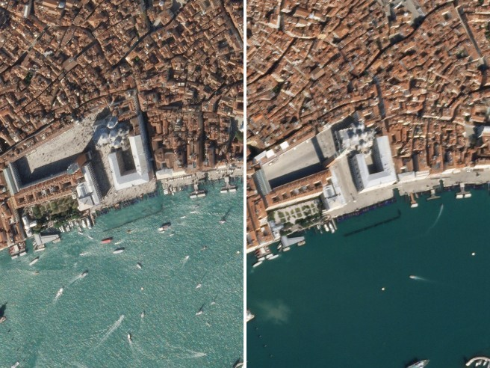
Venice

Slide 5
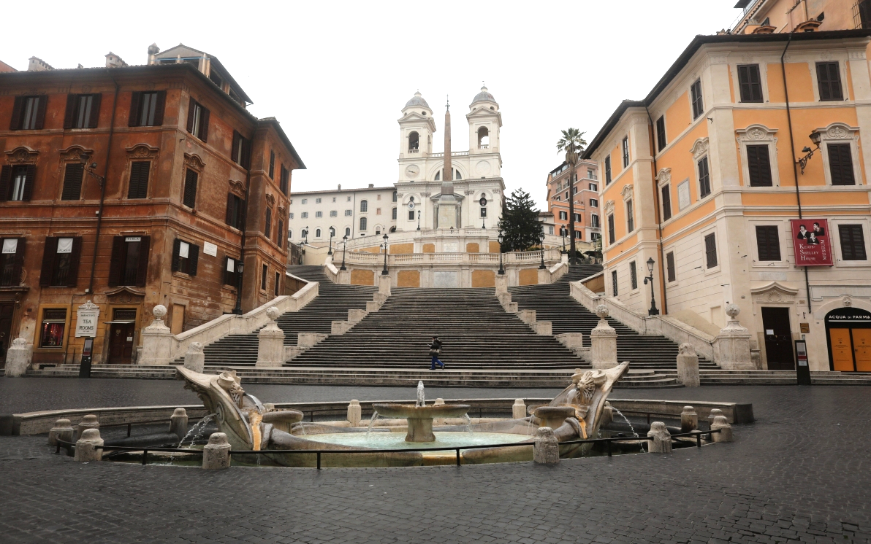
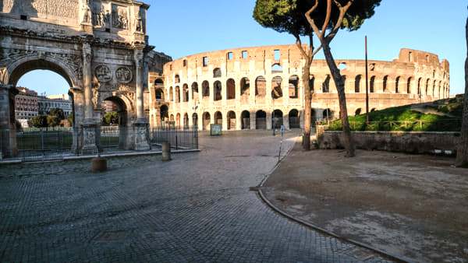
Rome

Slide 6
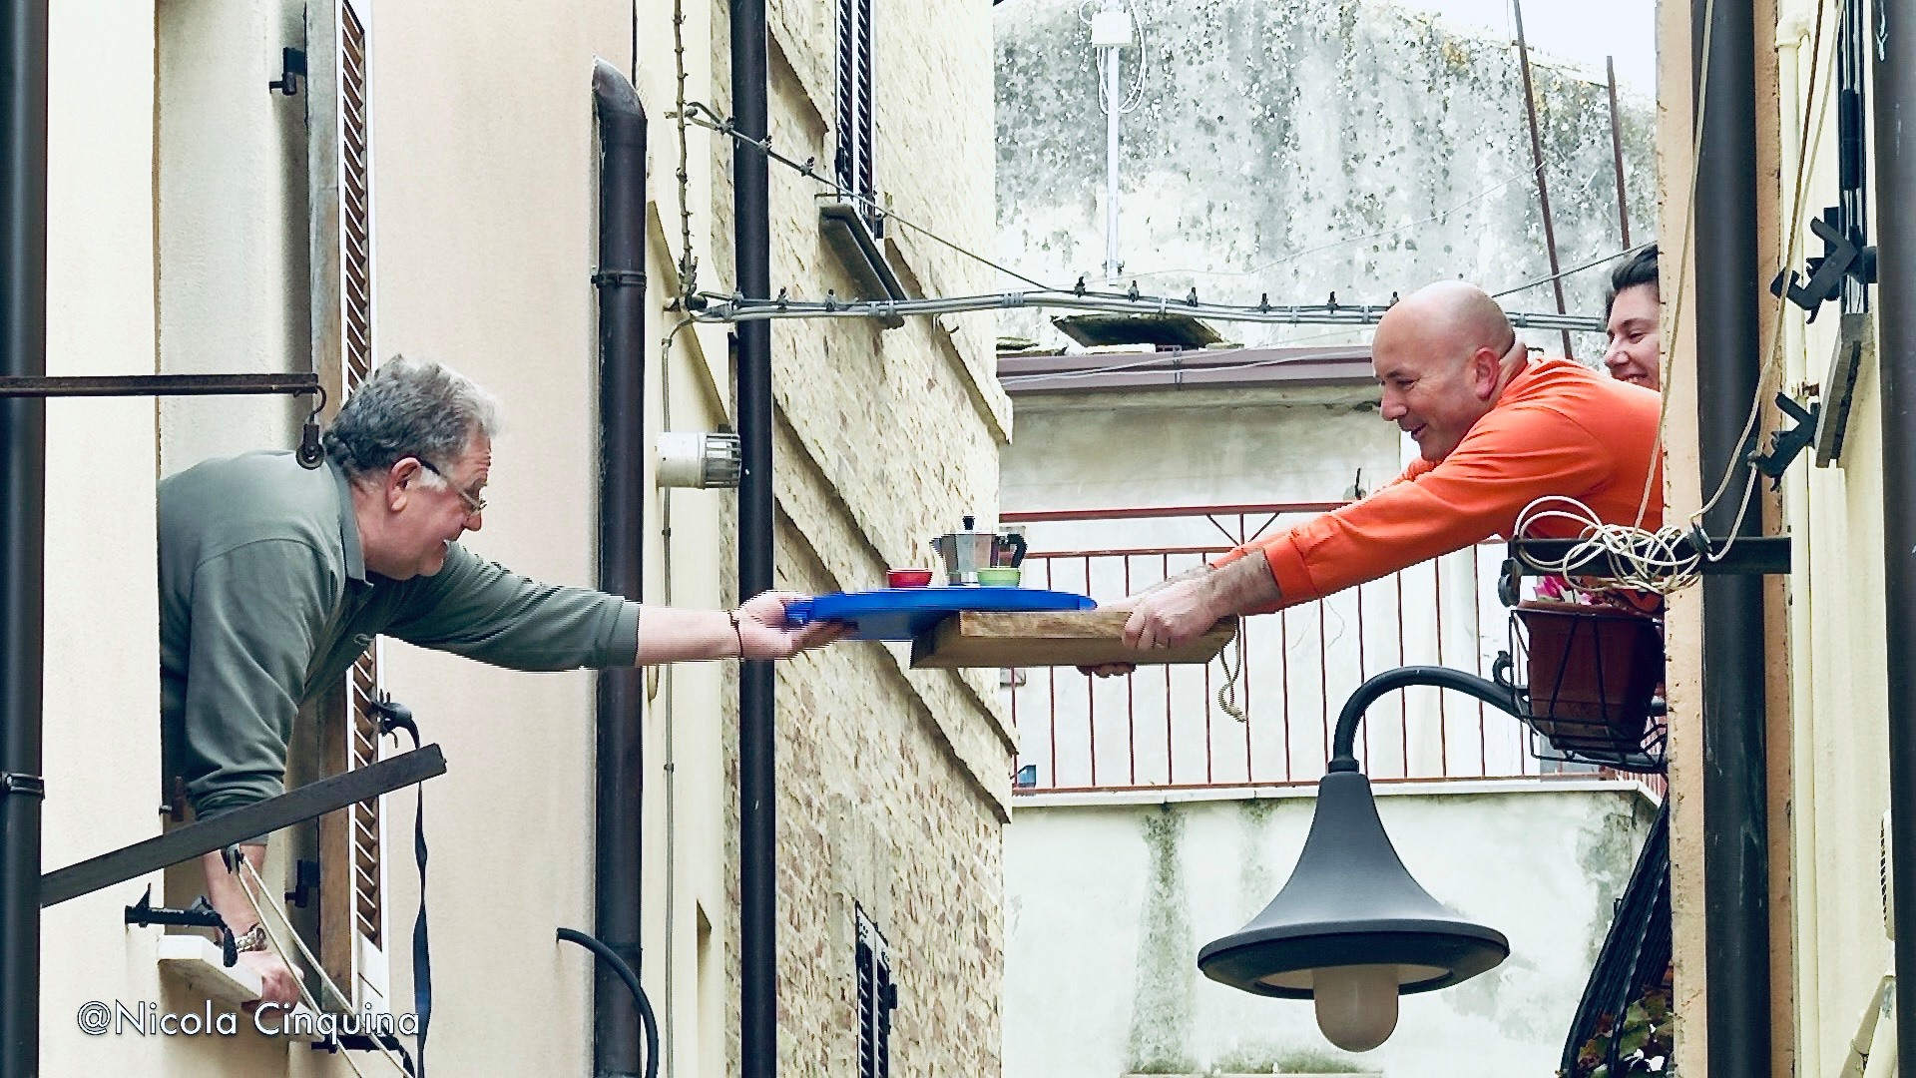
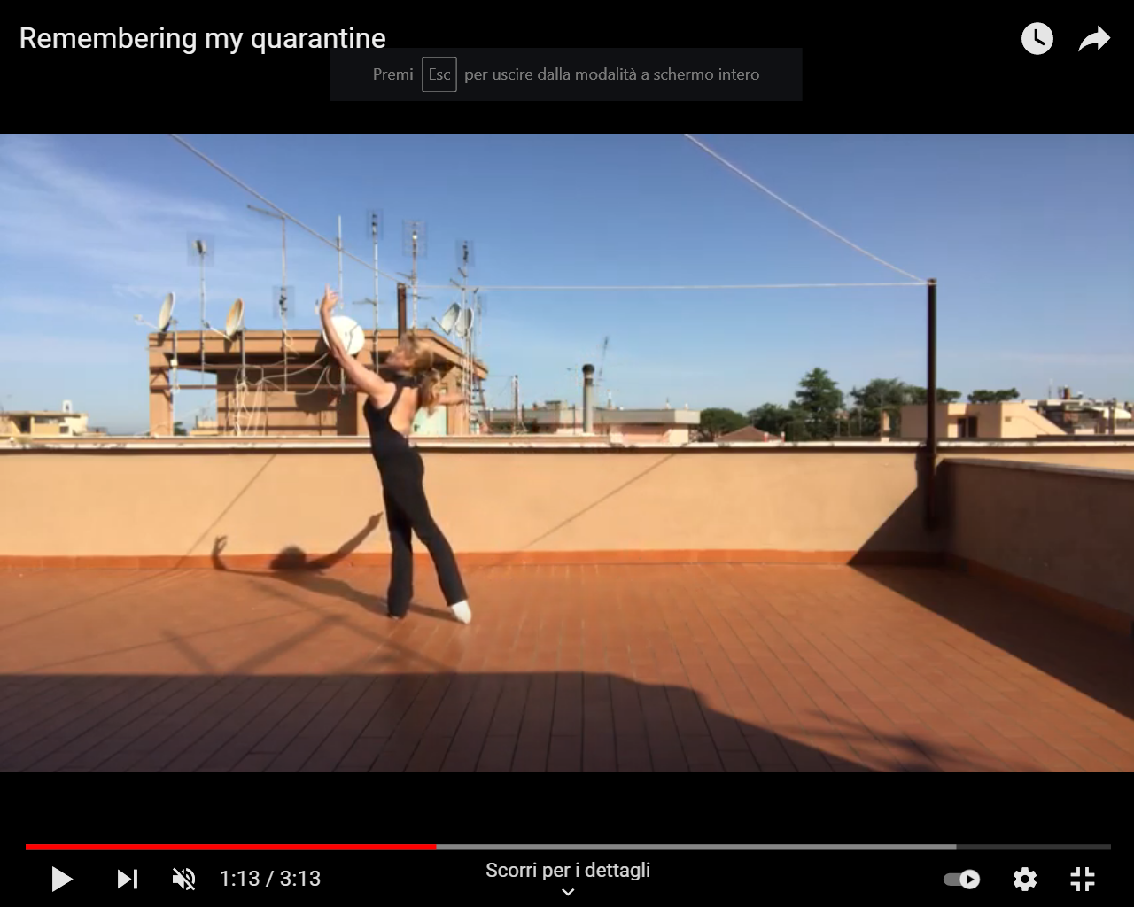
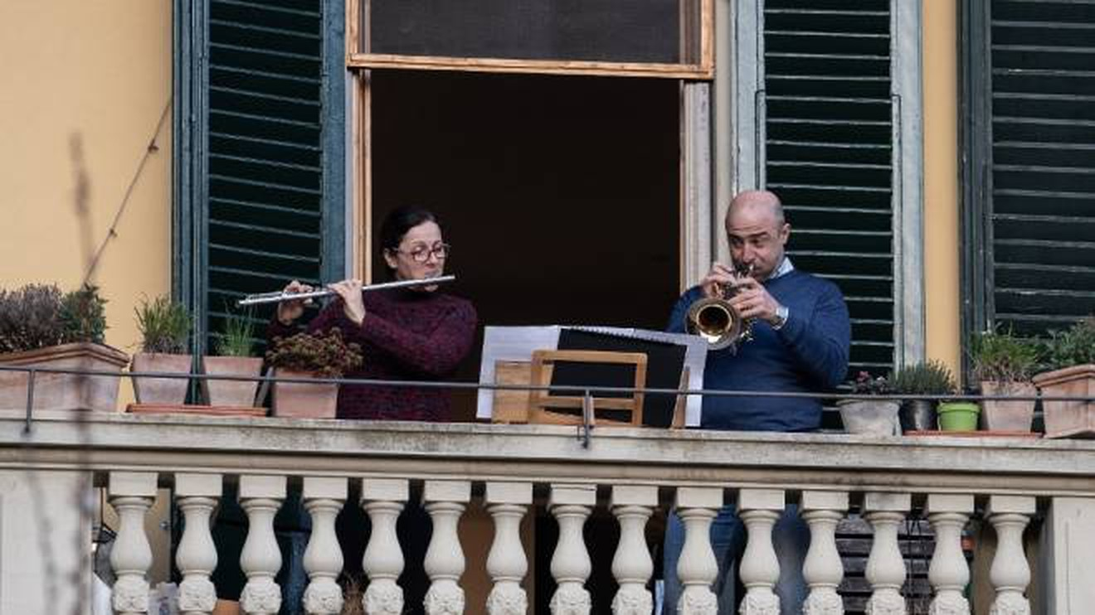
Survival actions by Italians

Slide 7
Large number of studies on air quality from ground-based sampling all over the world are available in the literature: different results in different locations, difficult to be resumed into a convincing overall interpretation.
Required a greater use of remote sensing observations to support the interpretation of air quality observations.
A widE-Ranging investigation of the COVID-19 LOCkdown effects on the atmospheric composition
in various Italian Urban Sites” (AER–LOCUS)
DOI 10.1016/j.uclim.2021.100954
Aim:
1) To integrate, for the first time in Italy, observations from different platforms: in-situ and remote sensing, from ground-based and space-borne instruments.
Particle and gas concentrations from in situ sampling
column aerosol and gas properties from photometers (ESR/SKYNET and AERONET) and spectrometers (PANDONIA)
TROPOMI NO2 determinations.
2) To Identify the medium- and long-range transport cases and isolate the variations of the main atmospheric pollutants due only to the restrictions.
synergistic network of measurements
examination of differences in meteorological conditions occurring in 2020

Slide 8
Identify the medium- and long-range transport cases and isolate the variations of the main atmospheric pollutants due to the restrictions :
a key point representing an additional, novel aspect
Concentration changes at urban sites are due to a combination of factors:
local emissions,
medium- and long-range transport,
atmospheric vertical stability.
Days affected by medium- and long-range transport were identified based on.
ERA5 re-analyses (Hersbach et al., 2020) to highlight periods of atmospheric stagnation that favored pollutant accumulation, followed by transport from one site to another.
column aerosol content, HYSPLIT trajectories (Stein et al., 2015) and Ceilometers RCS.
Data from the European Forest Fire Information System (EFFIS) for the detection of active fires from MODIS and VIIRS sensors (San-Miguel-Ayanz et al., 2012)
The 5 Italian urban sites: Milan, Bologna, Aosta, Rome and Taranto

Slide 9
The fundamental use of sun-photometry
First step for the identification of medium- and long-range air mass transport events
Spotting of AOD enhancements and variations of Angstrom exponent values.
Aerosols have a lifetime in the atmosphere spanning from a few days to weeks
and they are good tracers for air mass movements
Days with particularly high AODs: presence of a greater particle load in the entire atmospheric column,
possibly transported from other regions
The time evolution of the Ang parameter provides a qualitative indicator of the aerosol size during the enhanced AOD events: Ang ⪅ 1.0: size distributions dominated by coarse aerosols,
Ang ⪆1.5: indicate size distributions dominated by fine aerosols
Days with enhanced AOD were analysed along with HYSPLIT back-trajectories (96 h) to assess the origin of the air masses, and with Ceilometer profiles to identify the aerosol layer vertical distribution
The Lockdown period was characterized by numerous days of high atmospheric turbidity all over Italy, related to events of long-range and regional transport of pollutants.
Many of these events were recognized simultaneously at all the stations, confirming their large-scale character.

Slide 10
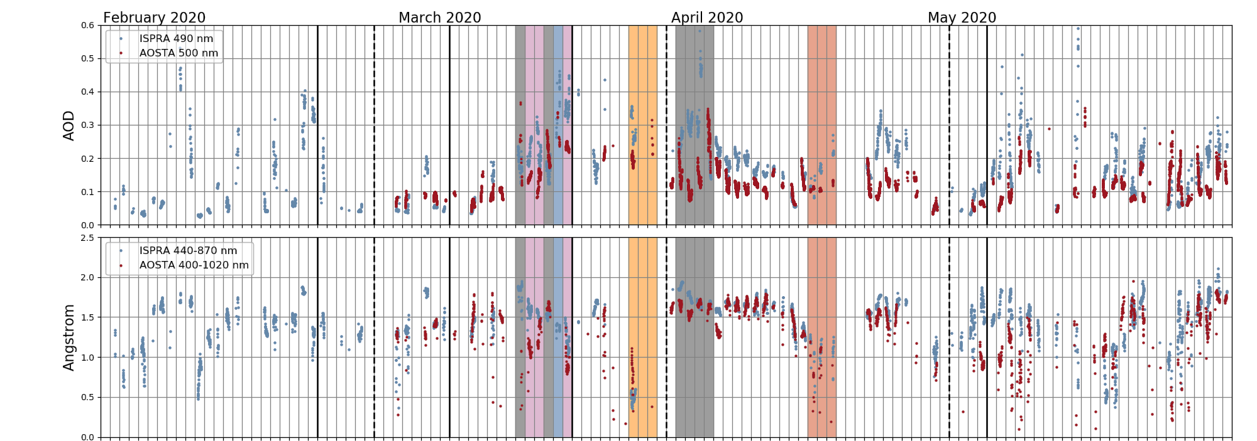
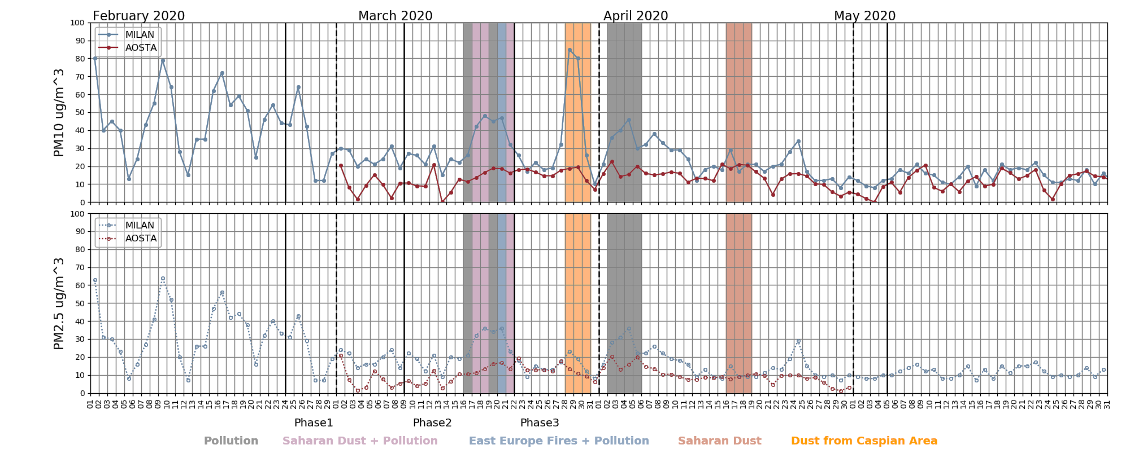
phase 1 (DPCM-1) [Feb.24 - March 8 only for Milan];
phase 2 (DPCM-2), [March 9 - March 21];
phase 3 (DPCM-3), [March 22 - May 4].
AOD, Ang, PM10, PM2.5 time series for two northern sites. Coloured areas refer to the identified specific events.

Slide 11
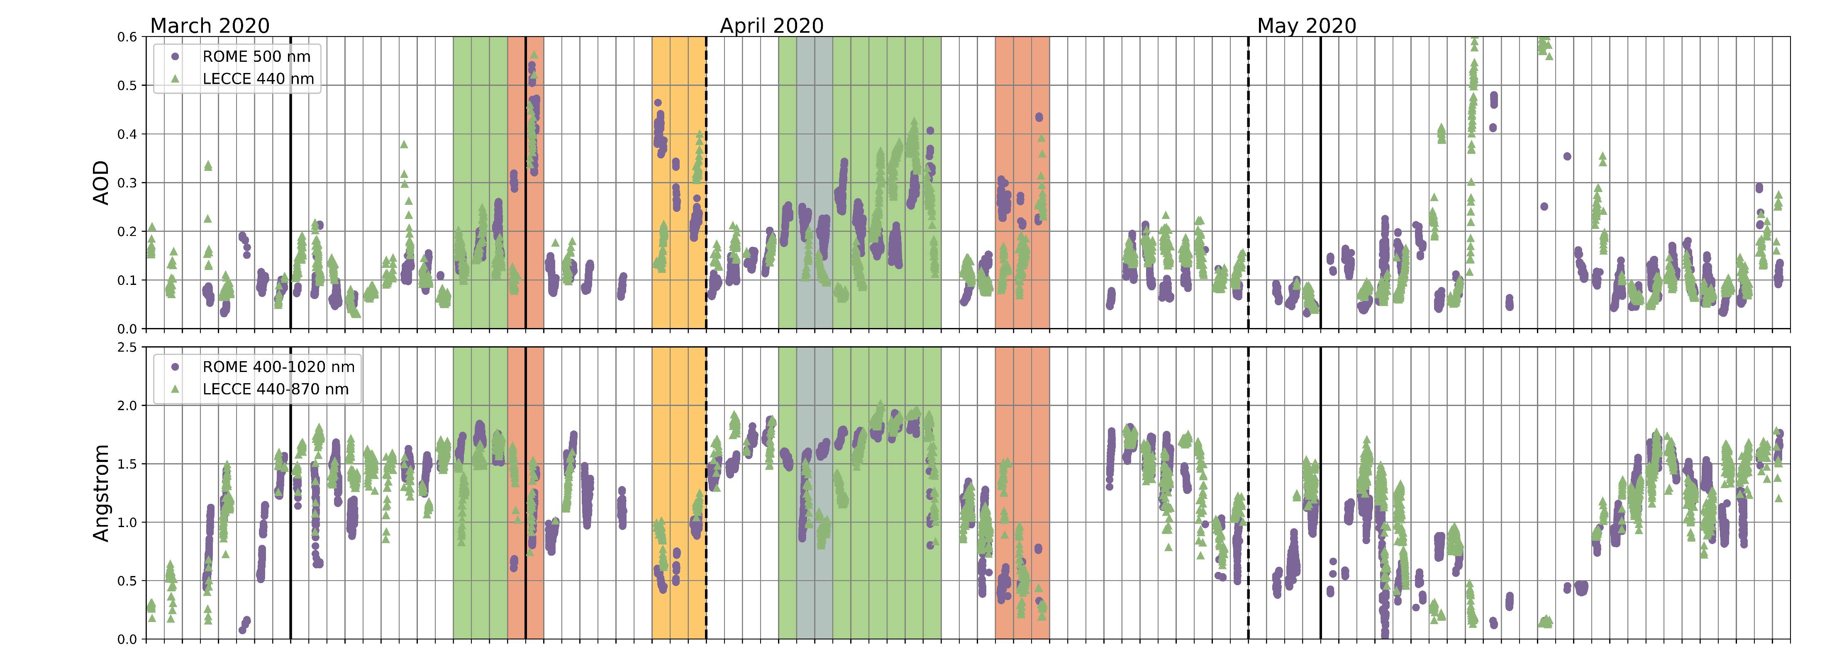
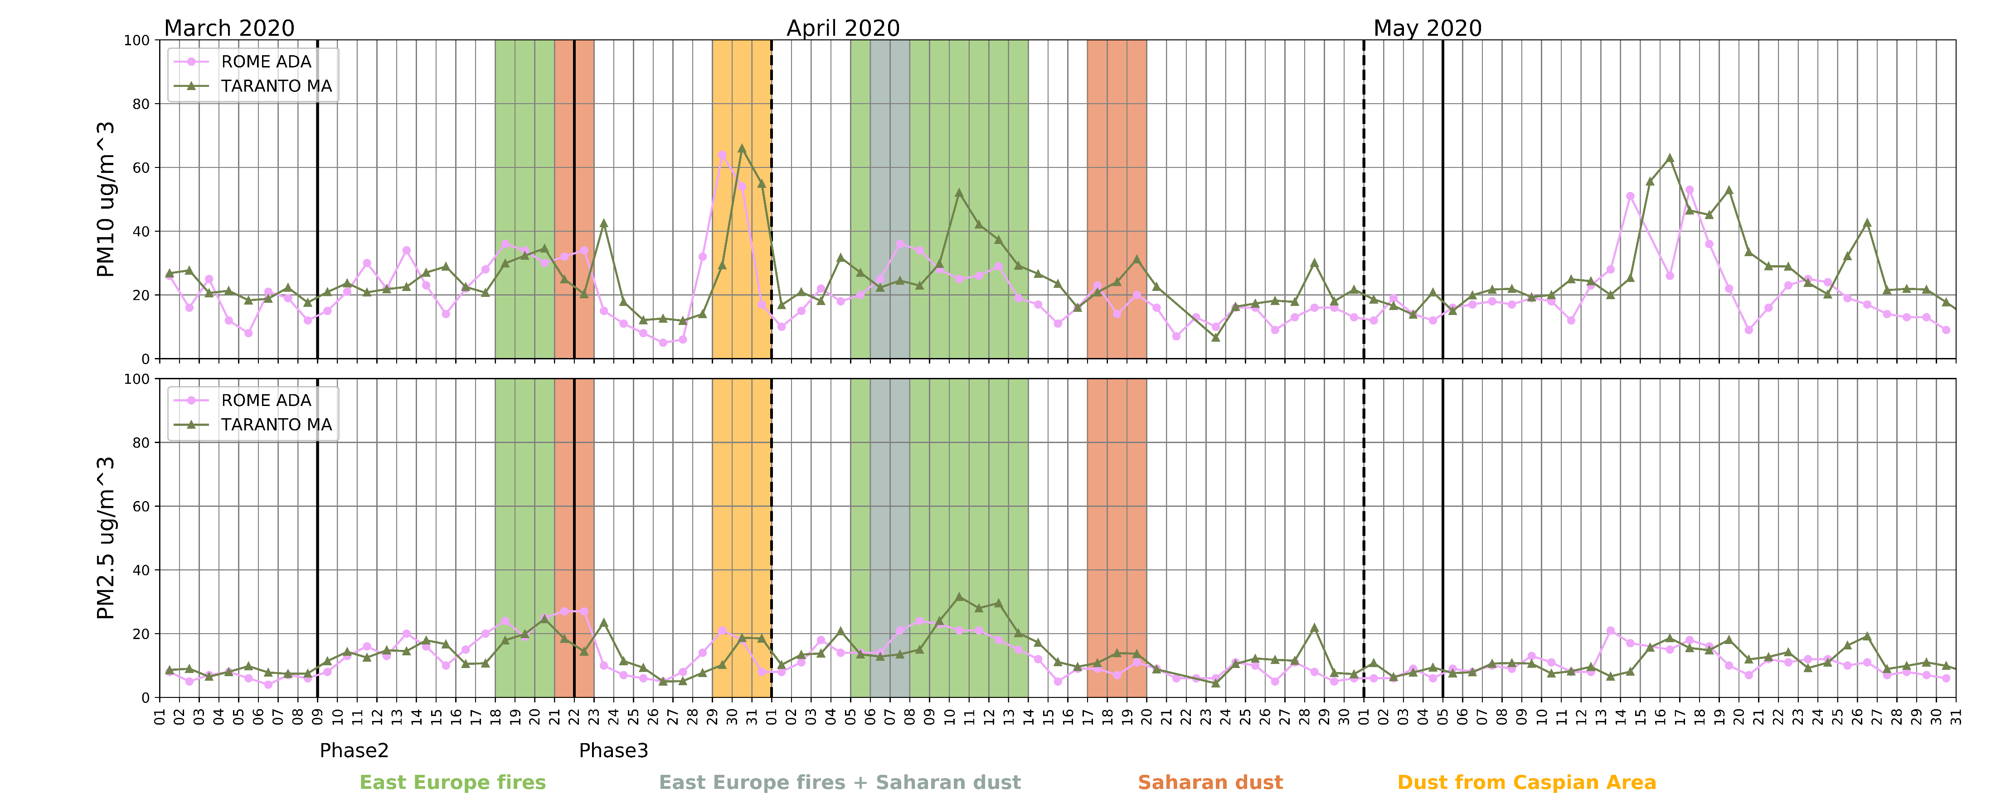
AOD, Ang, PM10 and PM2.5 time series for the two central and southern sites. Coloured areas refer to the identified specific events

Slide 12
Fires
Developed in Eastern Europe in March and April, markedly affecting air quality and atmospheric composition in the investigated area.
Fire plumes crossing the Adriatic Sea towards central and southern Italy were clearly detected in MODIS images of 8–10 April 2020.

Slide 13
Dust from the Caspian area
As reported by EUMETSAT (https://www.eumetsat.int/aralkum-desert-dust-pollutes-air-south-east-europe), a phenomenon of dust large-scale transport from Eastern Europe occurred at the end of March 2020
This event was favored by a depression area located over the Mediterranean Sea. Sensors on several satellites (e.g., SENTINEL 3, Meteosat 8, Terra and Aqua) showed the formation of a “dust-storm” in the Lake Aral area (eastern Europe, the Caspian Sea area), currently completely dried up.
RCS vertical profile from ALICE-net ceilometers in Milan (left) and Rome (right) on March 28 and 29, respectively
Saharan dust
Another typical feature of the spring period in Italy and the Central Meditteranean is the frequent transport of Saharan dust plumes
Medium-range pollution
Two periods of intense stagnation (16–20 March and 2–5 April), favored by meteorological forcing, were recorded at the sites of Milan and Bologna. During these periods pollutants were transported along the Po Valley to the site of Aosta.

Slide 14
Results
Once the long-range transport events are identified and excluded, the variation of gas and particle concentrations occurring during the containment period is calculated with respect to the period 2015–2019.
A general decrease of:
PM10 [− 52% in Aosta ÷ − 4% in Taranto]
PM2.5[− 46% in Aosta and Milan ÷ − 0.6% in Bologna]
BC [− 77% in Aosta ÷ − 25% in Milan]
NO2 [− 72% in Rome ÷ − 4% in Taranto]
Benzene [about− 50%]
A positive variation of:
PM2.5 during March in the southern sites due to some stagnation events,
benzene (up to +104%) in the industrial area of Taranto.
Ozone about 30% in all sites.
The reduction of concentrations after the removal of the long-range transport contributions, increased up to:
22% for PM10 and 29% for PM2.5 in the northern sites,
18% for PM10 and 16% for PM2.5 in the southern sites.
For NO₂ 14% in Milan and 6% in the southern sites,
for the aerosol optical depth up to 70% in Aosta and 50% in Rome.
Deeper analysis of what happened in Aosta if long range transport are not removed can be found in Air Quality in the Italian Northwestern Alps during Year 2020: Assessment of the COVID-19 «Lockdown Effect» from Multi-Technique Observations and Models, Diémoz et al., 2021, DOI 10.3390/atmos12081006

Slide 15
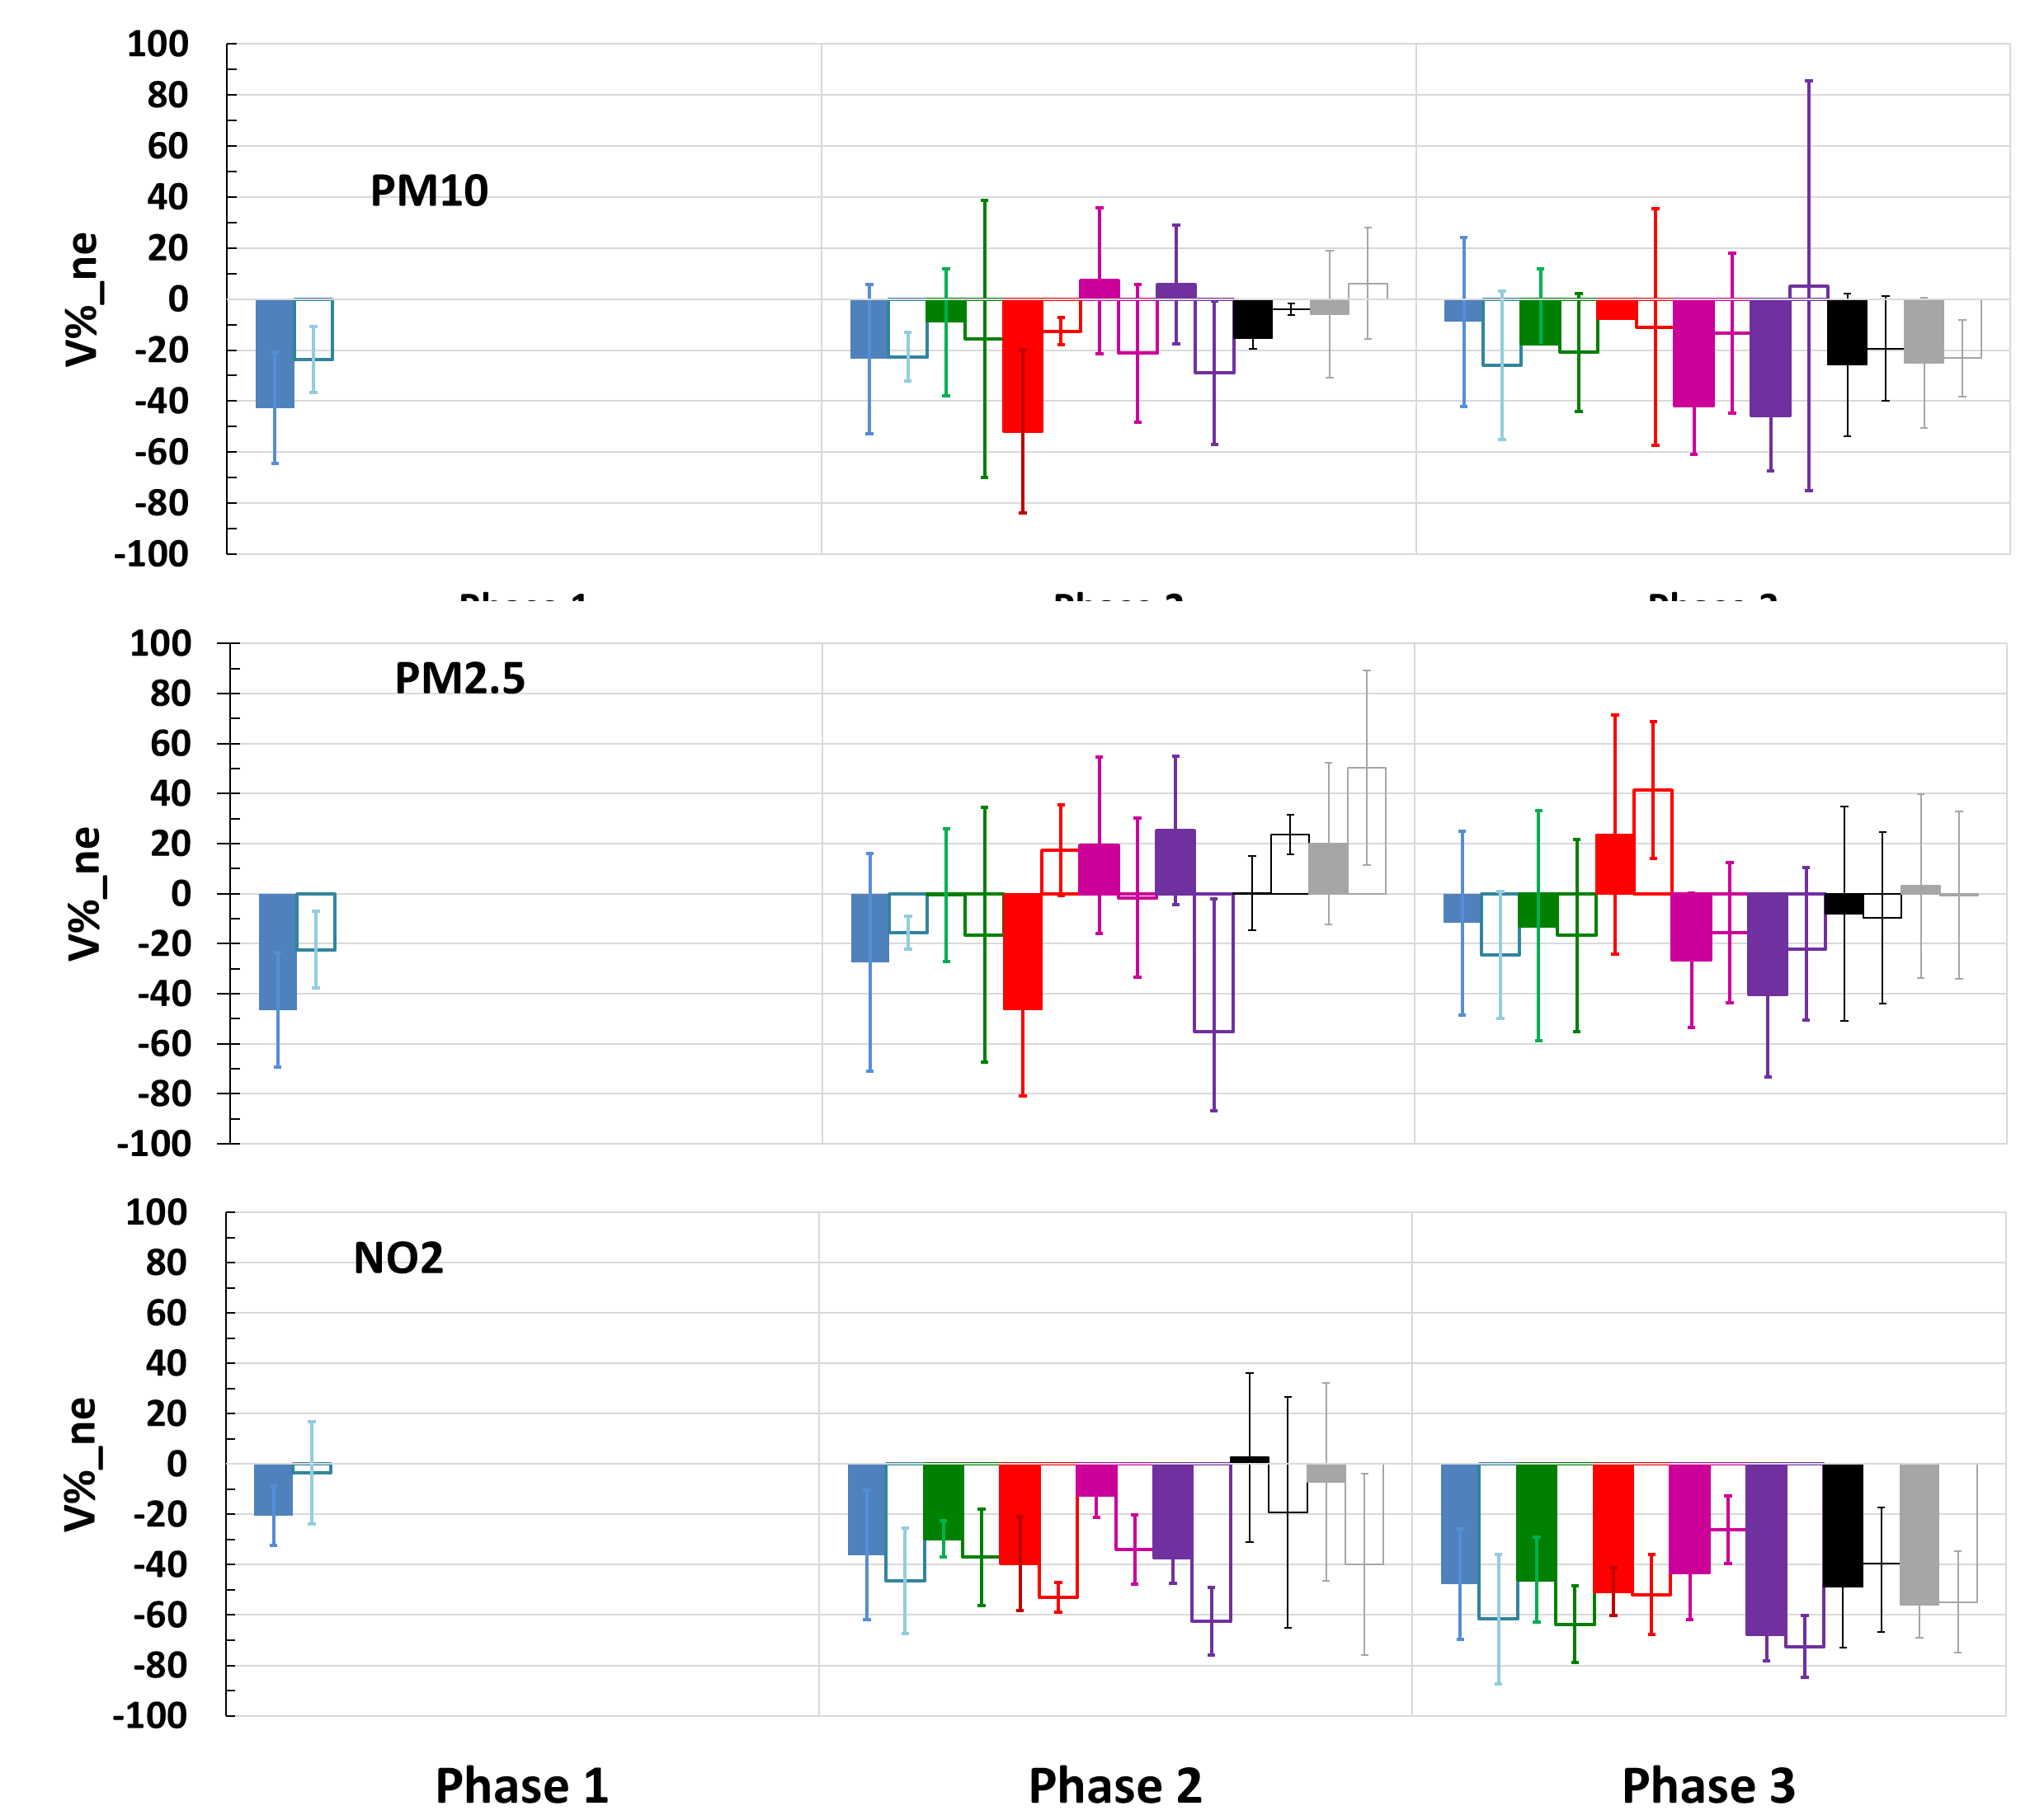
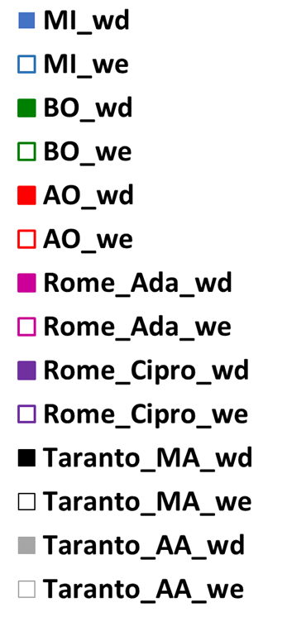
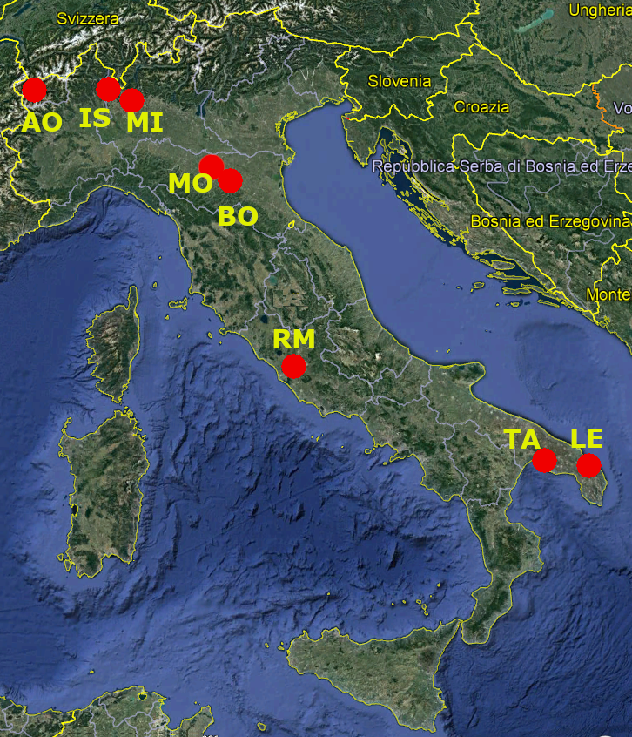
AER – LOCUS: A wide-ranging investigation of the COVID-19 lockdown effects on the atmospheric composition in various Italian urban sites
Relative variation of gas and particle concentrations cleared of the four different types of long-range transport over Italy
Fires plumes from Eastern Europe and Montenegro
Dust from the Caspian area
Saharan desert dust
Pollution from the Po Valley
wd: working days
we: weekend days

